Slide 1
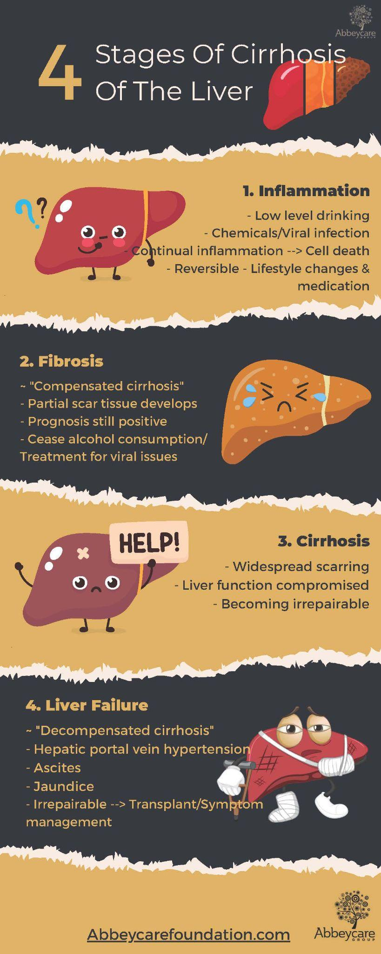
Liver Cirrhosis Stage Classification
Project 4, Group 2
Anna Bitzer, Amy Dohlin, Christine Jauregui, Tianyue Li
June 10, 2024

Slide 2
Data Set
Context:
Cirrhosis results from prolonged liver damage, leading to extensive scarring, often due to conditions like hepatitis or chronic alcohol consumption.
The data provided is sourced from a Mayo Clinic study on primary biliary cirrhosis (PBC) of the liver carried out from 1974 to 1984.
Data have been manually cleaned and synthetic data was generated to increase samples.
19 Features
25,000 observations
Source: https://www.kaggle.com/datasets/aadarshvelu/liver-cirrhosis-stage-classification/data

Slide 3
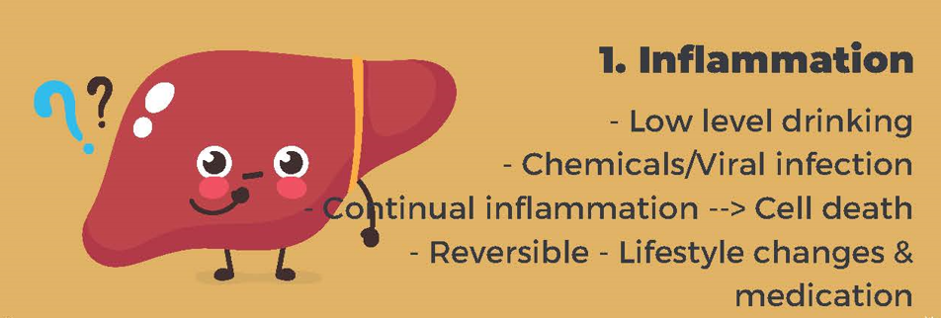
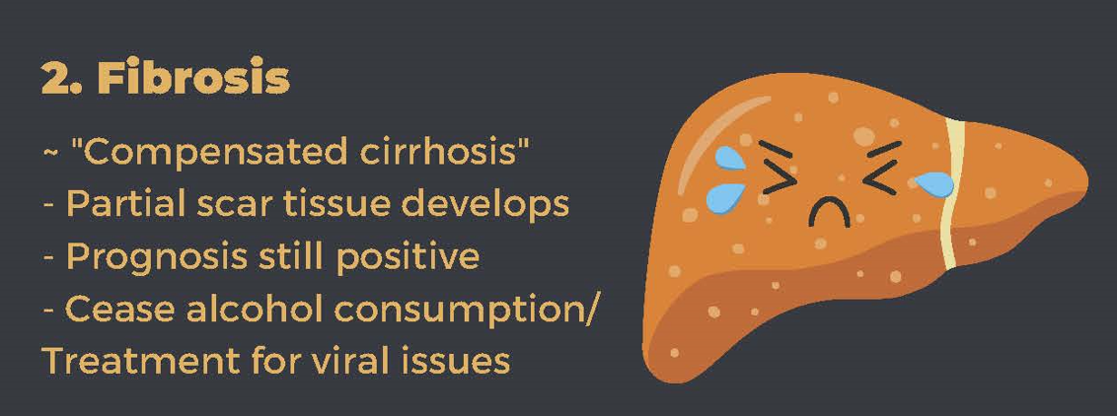
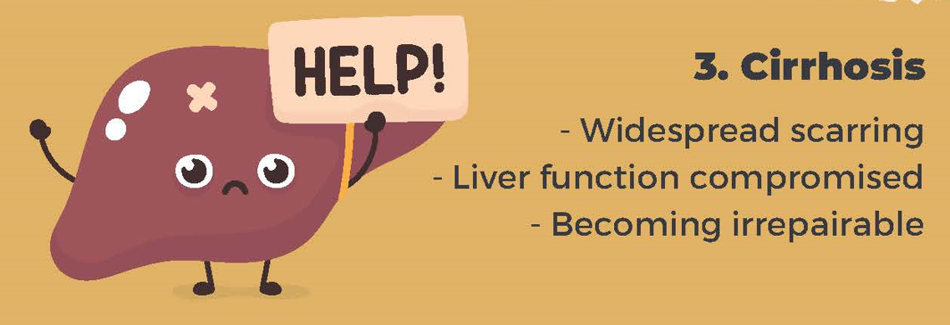

Slide 4
1
Data
Cleaning

Slide 5
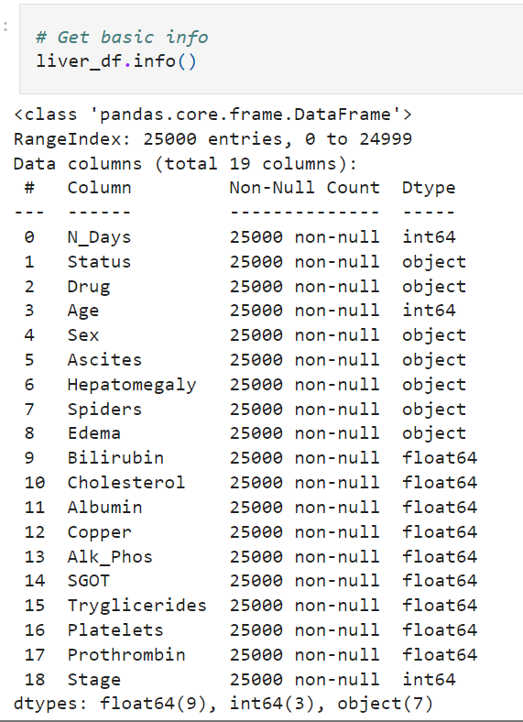
Pre-cleaned dataset in Kaggle
No null values
Included synthetic data
Dropped duplicates: 25,000 → 10,000 rows

Slide 6
2
Preliminary
Visualizations

Slide 7
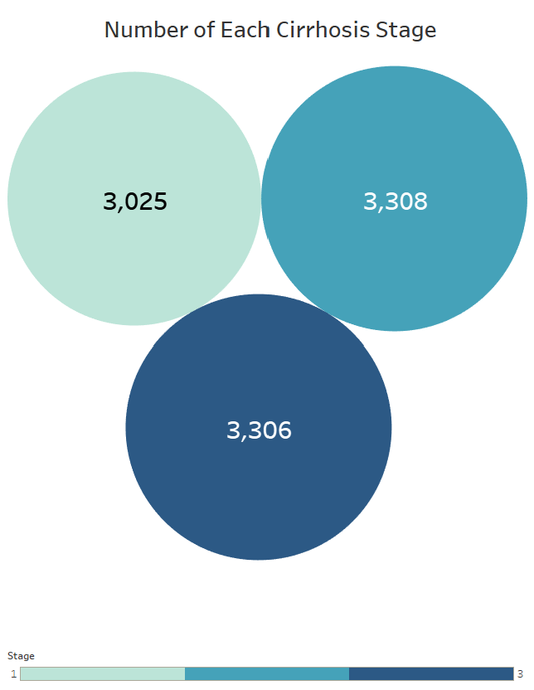
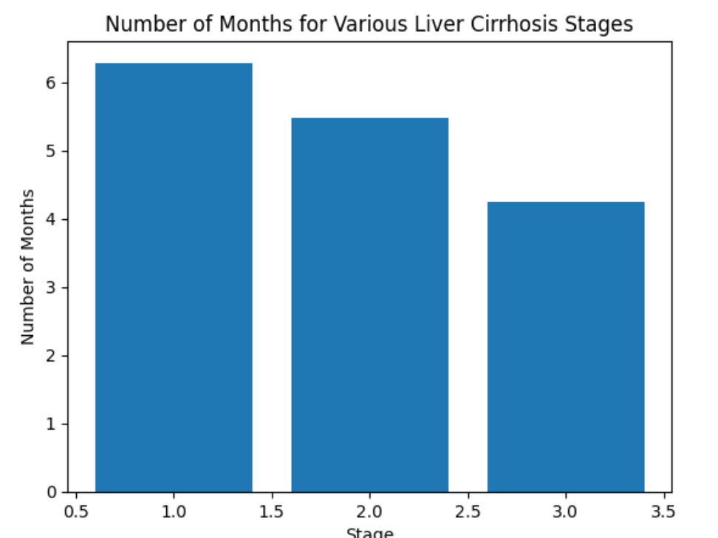
Matplotlib, Tableau

Slide 8
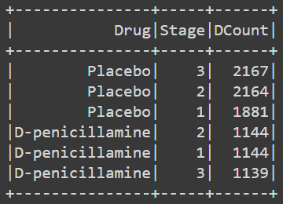
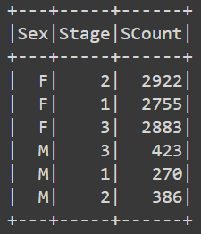
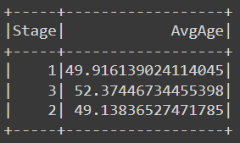
Spark SQL
Higher number of patients on the placebo than on the drug D-penicillamine.
The majority of patients were female.
The average age for stages 1 and 2 were 49 years old, the average age for stage 3 was 52 years old.
In female and male patients (across all stages and on both the placebo and the drug) had normal values for albumin, copper, triglycerides, and prothrombin, except for females with stage 3 (both placebo and drug) who had below normal levels of albumin.
For the same sets of female and male patients, all other bodily elements measured were found to be elevated, indicating liver cirrhosis.

Slide 9
3
Data
Transformation
(Preprocessing)

Slide 10
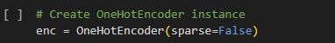
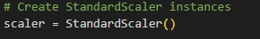
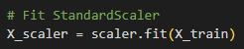
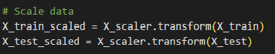
Pandas/Sklearn
1
Transform Categorical Variables (n=7)
2
Split Training and Testing Datasets
3
Scale the Data
4
Define Target Variable (Cirrhosis Stage 1, 2 or 3)

Slide 11
4
Neural
Network
Models

Slide 12
TensorFlow
Encoded, Scaled Data
57 Nodes
3 Layers
3 Units
Accuracy: 62.5%
Encoded, Scaled Data
65 nodes
3 Layers
3 Units
Accuracy: 61.0%
Encoded, Scaled Data
135 Nodes
5 Layers
3 Units
Accuracy: 61.3%
NEURAL NETWORK: ONE 3-CLASS TARGET
features = 27
loss=sparse_categorical_crossentropy
epochs = 100
1
2
3

Slide 13
TensorFlow
TensorFlow
Encoded, Scaled Data
57 Nodes
3 Layers
Accuracy: 60.7%
Encoded, Scaled Data
65 nodes
3 Layers
Accuracy: 62.5%
Encoded, Scaled Data
135 Nodes
5 Layers
Accuracy: 61.5%
NEURAL NETWORK: THREE 1-CLASS TARGETS
features = 27
loss=categorical_crossentropy
epochs = 100
1
NEURAL NETWORK: THREE 1-CLASS TARGETS
features = 27
loss=sparse_categorical_crossentropy
epochs = 100
THREE TARGET CLASSES
2
3

Slide 14
5
Model
Optimization

Slide 15

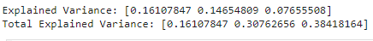
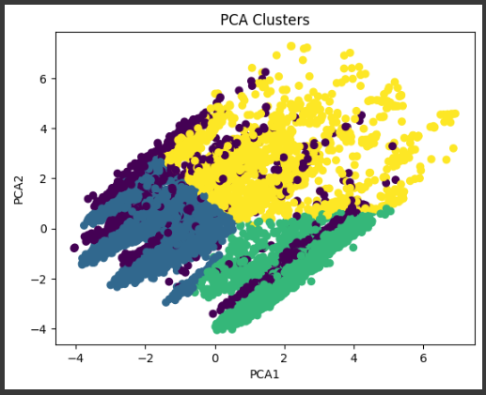
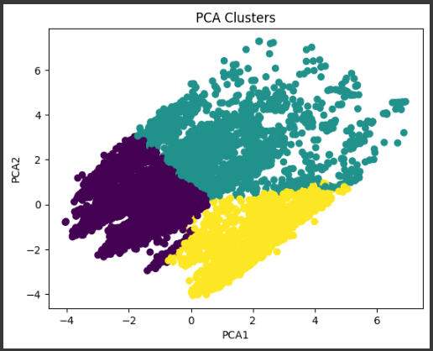
PCA Optimization
Max variance of 38% = only 38% of original data retained.
Tried 4 then 3 clusters.
Dataset does not have linear relationships.
PCA does not specify which variables it keeps.

Slide 16
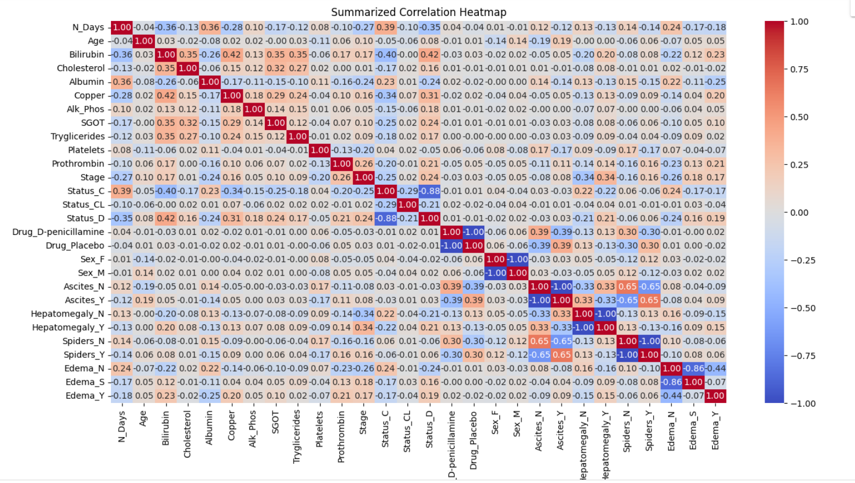
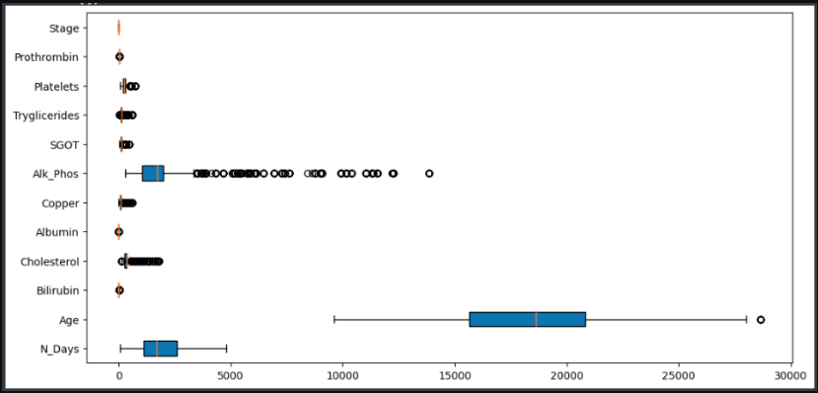
Step 1: Further understanding the dataset
HeatMap
Boxplot
To view the data spread and understand the variation of data
to view the relations of elements and identify strong players

Slide 17
1
2
3
What models and activations function to use
which features to model
number of hidden layers and neurons

Slide 18
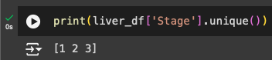
Step 2: Optimization with Keras Tuner
Extended hidden layers’ activations to a wider selection: Relu, Tanh, Sigmoid, leaky relu, softsign, exponential
Keras Tuner
Discovered the limitation of allowing only 1 output value when containing 3 output values
Added Softmax activation method to accommodate 3 outputs

Slide 19
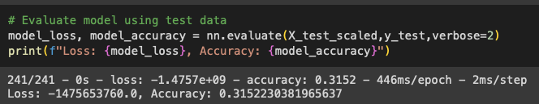
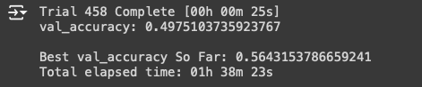
Step 3: Model Optimization Progress
31.5%
56.4%
65.0%
Original data accuracy
Keras Tuner auto-tuning
Improved neural network model
Used a neural network model with Relu and Sigmoid activation functions
Used keras tuner to automatically locate the most optimal hyperparameters
Used a neural network model with Relu, sigmoid, softmax
Used training data to reach the above calculated accuracy 92.79%
Used 1 output feature
3 total layers
100 epochs
Used 3 output units
Last layer softmax
100 epochs
Allowed different activations for input layer and hidden layers
Added additional activations, ex.“Leaky_relu”
Used 3 output units
Last layer softmax
4 total layers
100 epochs

Slide 20
6
Random
Forest
Model

Slide 21
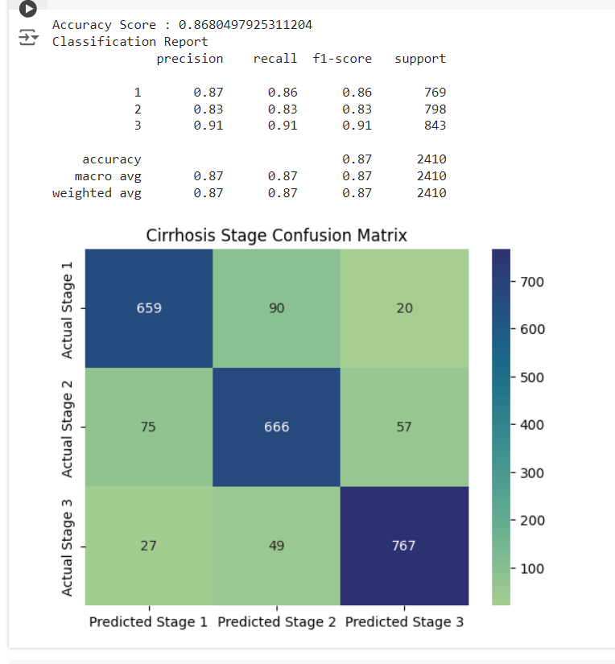
Sklearn, Seaborn

Slide 22
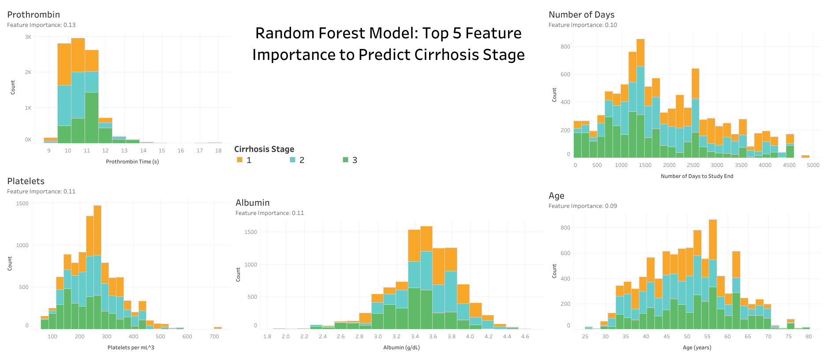
Sklearn, Tableau
Edgar Sandoval García, Guadalupe Graciela Ramos Rodríguez, Adrián Correa Torres

Slide 23
WERE MACHINE LEARNING MODELS SUCCESSFUL AT PREDICTING LIVER CIRRHOSIS STAGE?
Random Forest
Accuracy: 0.87
👍
Neural Network: SoftMax Activation
Accuracy: 0.65
😐
Neural Network: Relu Activation
Accuracy: 0.47
👎
PCA Clustering
Max Variance: 38%
👎

Slide 24
Add to TOC?
Questions?

